Slide 1
Stratified Adversarial Robustness with Rejection
Jiefeng Chen¹, Jayaram Raghuram¹, Jihye Choi¹, Xi Wu², Yingyu Liang¹, Somesh Jha^{1,3}
¹University of Wisconsin-Madison ²Google ³XaiPient
Notes:
Hi, everyone! I am Jiefeng Chen, a Ph.D. student in the computer science department. Today, I will introduce our paper ...

Slide 2
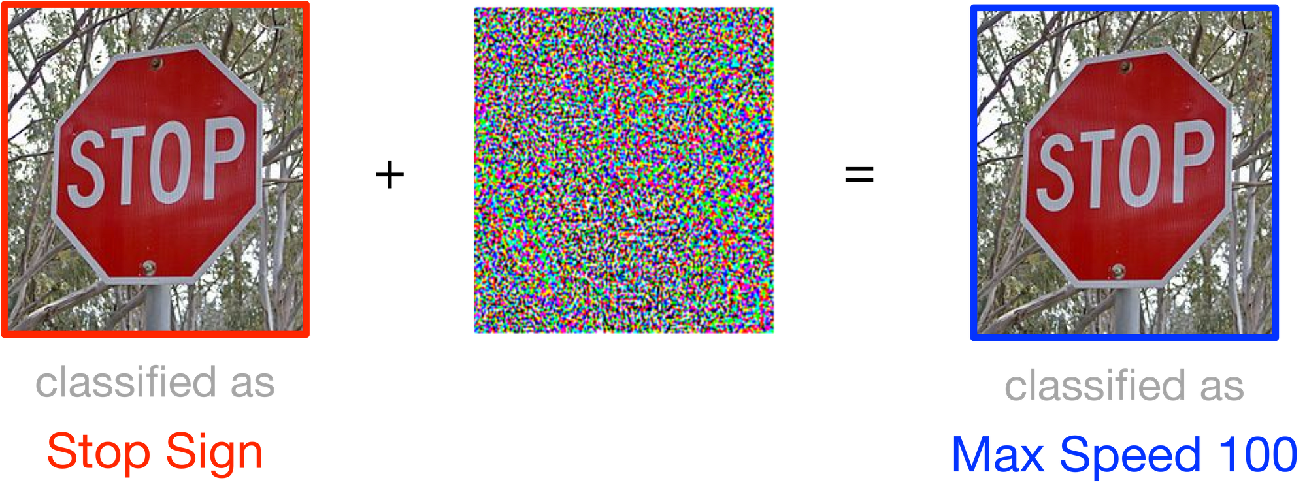


Adversarial Examples
Adversarial Example
$$+$$
$$=$$
classified as
Stop Sign
97% confidence
classified as
Max Speed 100
98% confidence
Notes:
Let me first explain what are adversarial examples. Given a stop sign image, a DNN can correctly classify it as stop sign with 97% confidence. If we add small perturbations to the stop sign image, the resulting image is very similar to the original image and clearly it is still a stop sign image. But the DNN will classify it as Max Speed 100 with 98% confidence. This is the adversarial example and it can cause severe consequences. For example, the self-driving car using the traffic sign classification system will make wrong actions before the stop sign and the car accidence may happen.

Slide 3


Challenges for Defense
I have adversarial training
I have made progress
Its robustness is still limited
I have been stronger
Defender
Attacker
Notes:
Thus, for safe deployment of DNNs, we need to make them robust to adversarial examples. Although a lot of defenses have been proposed, most of them have been broken by strong adaptive attacks. The most effective approach for improving adversarial robustness is adversarial training. However, adversarial training still does not achieve very high robust accuracy on complex datasets. For example, even state-of-the-art adversarially trained models struggle to exceed 67% robust test accuracy on the CIFAR-10 dataset.

Slide 4
A Rejection Option
Model
Max Speed 100
98% confidence
Reject
Notes:
One approach to break this adversarial robustness bottleneck is to allow the classifier to reject adversarial examples, instead of trying to correctly classify all of them. This can be especially crucial when it comes to real-world, safety-critical systems such as self-driving cars, where abstaining from prediction is often a much safer alternative than making an incorrect decision.

Slide 5

Cost for Rejection
Model
Reject
Notes:
Recently, several works have studied the problem of adversarially-robust classification with rejection. However, they usually do not consider a cost for rejecting perturbed inputs, which may end up rejecting too many slightly-perturbed inputs that could be correctly classified. In fact, in many practical applications (e.g., autonomous driving systems), rejecting an input may result in the need for human intervention, which is expensive.

Slide 6
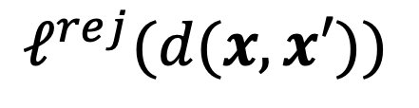
Rejection Loss
We focus on monotonically non-increasing rejection loss $ℓ^{rej}(r)$.
Clean input
Perturbed input
$$ℓ^{rej}(d(x, x′))$$
Perturbation Magnitude
Notes:
Thus, when the model rejects the perturbed input, we will associate a loss with the rejection decision. Specifically, the rejection loss is a function of the perturbation magnitude, which is the distance between the clean input x and the perturbed input x’. We can use the L_p norm as the distance function. In our work, we focus on …

Slide 7





Total Robust Loss
Maximum of the two losses
$$L_{ε}\left(f;ℓ^{rej}\right)≔$$
$$1\left\{f\left(x^{′}\right)=⊥\right\}ℓ^{rej}(d(x,x′))$$
$$\max_{x^{′}∈𝒩(x, ε)}{[ ]}$$
$$𝔼_{\left(x,y\right)∼𝒟}$$
$$1\{f\left(x^{′}\right)∉\{y,⊥\}\}$$
$$∨$$
Worst-case perturbation
Mis-classification loss
Rejection loss
Notes:
Given a rejection loss, we define a total robust loss for evaluation. We have a loss for misclassification and a loss for rejection. Then we take the maximum of the two losses to get a total loss. Finally, we find the worst-case perturbation that maximizes the total loss to get the total robust loss.

Slide 8
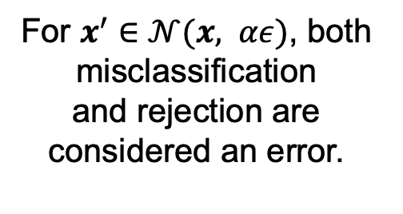
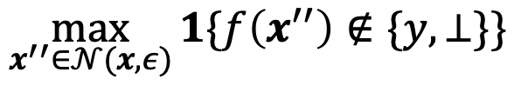



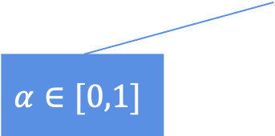
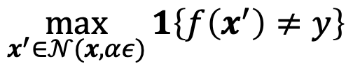
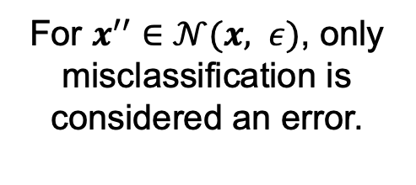
Robust Error with Rejection
Maximum of the two losses
$$R_{ε}^{rej}\left(f,α\right)≔$$
$$𝔼_{\left(x,y\right)∼𝒟}$$
$$\max_{x^{′}∈𝒩(x, αε)}{1\left\{f\left(x^{′}\right)≠y\right\}}$$
$$∨$$
$$\max_{x^{′′}∈𝒩(x, ε)}{1\{f\left(x^{′′}\right)∉\{y,⊥\}\}}$$
$$α∈[0,1]$$
For $x^{′}∈𝒩(x, αε)$, both misclassification
and rejection are considered an error.
For $x^{′′}∈𝒩(x, ε)$, only misclassification is considered an error.
Notes:
We define another metric called robust error with rejection at \alpha. The intuition behind the metric is that for perturbations within the \alpha\epsilon neighborhood, both misclassification and rejection are considered an error, and for perturbations within the \epsilon neighborhood, only misclassification is considered an error. Here, the V shape symbol means the maximum of the two losses and the value of \alpha is between 0 and 1.

Slide 9

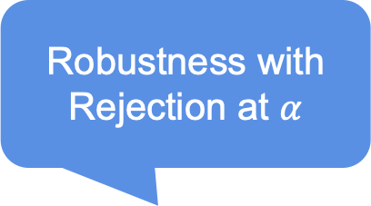
Robustness Curve
Robustness with Rejection at $α$
$$\{1−R_{ε}^{rej}\left(f,α\right):α∈[0, 1]\}$$
Notes:
We define the robustness with rejection at \alpha as one minus robust error with rejection at \alpha. Then we define a new metric called robustness curve, which is the robustness with rejection for \alpha between 0 and 1. We can plot the robustness curve. The x-axis is \alpha and the y-axis is robustness with rejection.

Slide 10
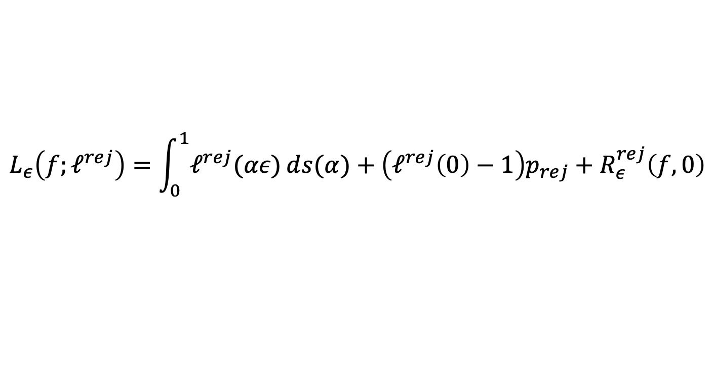
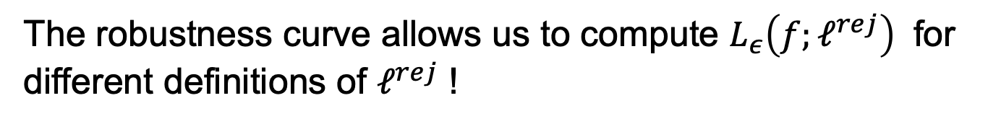

Utility of Robustness Curve
The robustness curve allows us to compute $L_{ε}\left(f;ℓ^{rej}\right)$ for different definitions of $ℓ^{rej}$ !
$$L_{ε}\left(f;ℓ^{rej}\right)=\int_{0}^{1}{ℓ^{rej}(αε)ⅆs(α)}+\left(ℓ^{rej}\left(0\right)−1\right)p_{rej}+R_{ε}^{rej}\left(f,0\right)$$
$$s\left(α\right)≔R_{ε}^{rej}(f,α)$$
$$p_{rej}≔Pr⁡[f\left(x\right)=⊥ ∧(∀x^{′}∈𝒩\left(x, ε\right), f\left(x^{′}\right)∈\{y,⊥\})]$$
Notes:
The robustness curve allows us to compute the total robust loss for different definitions of the rejection loss function.
The formula is this.
s(\alpha) is the robust error with rejection at \alpha
p_rej is the probability that the clean input x is rejected and no perturbations of x within the ε-ball are misclassified.

Slide 11
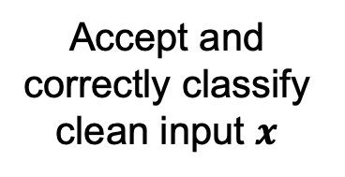
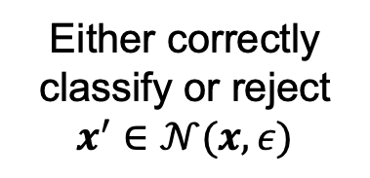
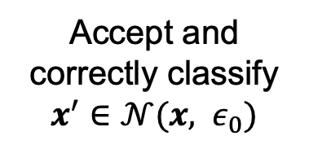
Stratified Adversarial Training with Rejection
$$\min_{θ}{𝔼_{\left(x,y\right)∼𝒟}[ℓ_{CE}\left(x,y;θ\right)+β\max_{x^{′}∈𝒩\left(x, ε_{0}\right)}{ℓ_{CE}\left(x^{′},y;θ\right)}+γ\max_{x^{′}∈𝒩(x, ε)}{ℓ_{CE}^{rej}(x^{′},y;θ)}]}$$
Accept and correctly classify clean input $x$
Accept and correctly classify $x^{′}∈𝒩(x, ε_{0})$
Either correctly classify or reject $x^{′}∈𝒩(x,ε)$
$$ℓ_{CE}\left(x^{′},y;θ\right)=−\log{[\left(1−h_{⊥}\left(x^{′};θ\right)\right)h_{y}(x^{′};θ_{c})]}$$
$$ℓ_{CE}^{rej}\left(x^{′},y;θ\right)=−\log{[\left(1−h_{⊥}\left(x^{′};θ\right)\right)h_{y}\left(x^{′};θ_{c}\right)+h_{⊥}\left(x^{′};θ\right)]}$$
Notes:
We propose a training objective for adversarially-robust classification with rejection called stratified adversarial training with rejection (SATR).
The training loss contains three terms: the first term aims to accept and correctly classify clean input x; the second term aims to accept and correctly classify all perturbed inputs in the \epsilon_0-neighborhood of x; the third term aims to either correctly classify or reject all perturbed inputs in the \epsilon-neighborhood of x.

Slide 12
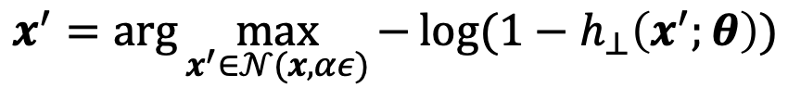
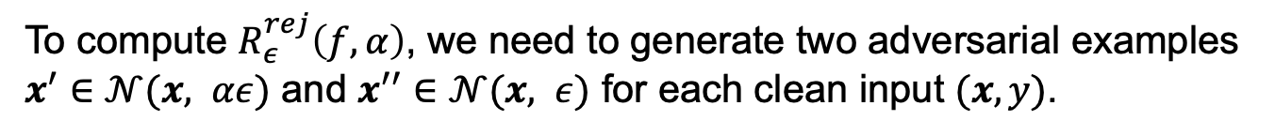
Adaptive Attacks for Evaluation
To compute $R_{ε}^{rej}\left(f,α\right)$, we need to generate two adversarial examples $x^{′}∈𝒩(x, αε)$ and $x^{′′}∈𝒩(x, ε)$ for each clean input $(x,y)$.
$$x^{′}=\arg{\max_{x^{′}∈𝒩(x, αε)}{−\log{(1−h_{⊥}\left(x^{′};θ\right))}}}$$
$$x^{′′}=\arg{\max_{x^{′′}∈𝒩(x, ε)}{−\log{(1−\left(1−h_{⊥}\left(x^{′′};θ\right)\right)\max_{j≠y}{h_{j}(x^{′′};θ_{c})})}}}$$
Notes:
To compute the robustness with rejection at \alpha, we need to generate two adversarial examples x’ and x’’ for each clean input (x, y). x’ is in the \alpha\epsilon-neighborhood and x’’ is in the \epsilon-neighborhood.
We use this objective to generate adversarial example x’. The goal of the objective is to find x’ such that the model will reject it.
We use this objective to generate adversarial example x’’. The goal of the objective is to find x’’ such that the model will accept and misclassify it.

Slide 13
Results of Total Robust Loss
Notes:
The figure shows the results of evaluating total robust loss of different methods under seen attacks. We can see that the proposed method SATR significantly outperforms existing methods with respect to different rejection losses.

Slide 14
Results of Total Robust Loss
Notes:
We also evaluate total robust loss of different methods under unseen attacks. The unseen attack have a perturbation budget that is larger than the one used for training. Under unseen attacks, our method SATR also significantly outperforms existing methods with respect to different rejection losses.

Slide 15
Results of Robustness Curve
Notes:
We further evaluate the robustness curve of different methods. Under seen attacks, Our method SATR has significantly higher robustness with rejection compared to the baselines for small to moderate \alpha values. The robustness with rejection of SATR only drops for large \alpha values, which are not likely to be of practical interest.

Slide 16
Results of Robustness Curve
Notes:
Under unseen attacks, our method SATR also significantly outperforms existing methods for small to moderate \alpha values.

Slide 17

Key Takeaways
We propose new evaluation metrics – the total robust loss and the robustness curve – that provide a fine-grained evaluation of the robustness with rejection.
We propose a novel training method SATR that achieves the state-of-the-art results under strong adaptive attacks.

Slide 18
THANK YOU!

